Slide 1
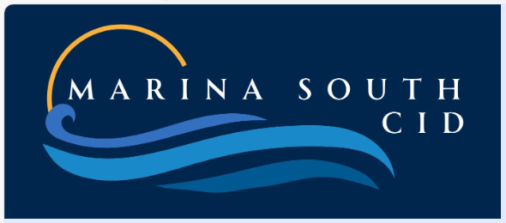
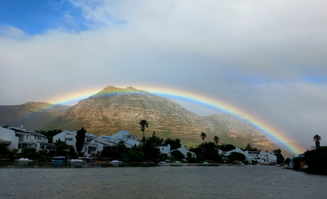
WELCOME TO THE SECOND PUBLIC MEETING
www.marinasouthcid.co.za

Slide 2
MEETING AGENDA
What is a CID?
How Does It Function?
How Did We Get Here?
What Have We Learnt?
What Happened Next?
Comments
How Will a CID Solve Our Problems?
Review Of Area
How Much Will It Cost?
What Happens Next?
Q & A
Please save your questions & comments for the end

Slide 3
WHAT IS A CID?
It is a defined Geographically Contiguous area
All property owners in the area fund additional rates
  except for those who receive a rates rebate (indigent or pensioners)
Additional rates are used to fund supplementary services for the CID area (according to the approved Business Plan)

Slide 4
HOW DOES IT FUNCTION?
It is Community Driven
  Managed by Property Owners in the area
  Property Owners define the needs and how the funds are spent
Funding collected by the City from property owners
City pays money over to CID monthly as per the budget
Expenditure reports tabled at monthly Board meetings and sent to the City

Slide 5
HOW DID WE GET HERE?
A Geographically representative group of Property Owners within Marina South volunteered to form a Steering Committee
  Initiated the process in terms of the City By-law and Policy
Conducted an Urban Management Survey to establish Priorities
  82 Responded
  89% rated Public Safety & Security of Highest Priority

Slide 6
WHAT DID WE LEARN?
The importance of feeling safe walking in Marina South
The importance of children to be safe as they walk/play/cycle in Marina South
The importance of being timeously alerted to threats and incidents in Marina South
Improve the Monitoring & Detection of crime in Marina South
Improve the overall quality of Response to Crime Incidents in Marina South
Improve the cleanliness of our Public Areas & Facilities

Slide 7
WHAT HAPPENED NEXT?
Developed a draft Business Plan under City supervision
Held 1st Public Participation Meeting on 13th August
Comment Period opened from 13 August to 14 September 2025
Processed submissions made during the Comment Period

Slide 8
COMMENTS RECEIVED
Comments received from 13 people relating to -
  Boundaries (6)
  Financial Impact (5)
  Public Safety (3)
  Implementation Plan (3)
  Management (1)
  Maintenance & Cleaning (1)
  Environmental Development (1)
  Social Responsibility (1)
  Sundry others (5)
Full details available in the Final Business Plan on the website

Slide 9
RESPONSES TO COMMENTS
Boundaries remain the same with a change to the Business Plan
  The proposed boundaries of the CID match the current camera coverage of the Marina South area and is currently funded by voluntary contributions which indicates support for Safety initiatives. This is not the case for properties on the East side of Eastlake Drive, which could hamper efforts to create Marina South CID
  The plan now includes an increased monitoring of cameras and response to suspicious incidents in the public areas
  A comprehensive review of the location of cameras to ensure increased and equitable camera coverage for the properties within the CID boundaries

Slide 10
RESPONSES TO COMMENTS
Financial Impact
  A CID replaces the process of voluntary contributions to street security, thereby assuring the consistent funding required
  The proposed MSCID Budget remains the same
  Everything provided for in the proposed MSCID Budget is supplementary to, not a duplication of, that of MDGA or CoCT
  When the new GV becomes available the additional rate will be adjusted proportionally based on the changes between the current valuation roll and the new General Valuation Roll

Slide 11
RESPONSES TO COMMENTS
Public Safety
  The MSCID proposes to expand the CCTV coverage and increase the effective monitoring of cameras
  A CID replaces the process of voluntary contributions to street security, thereby assuring the consistent funding required

Slide 12
RESPONSES TO COMMENTS
Remaining Comments
  Referred commenters to relevant by-law, policy or organisation
  Two requested exclusion from area, which is not possible
  Two indicated support for the initiative

Slide 13
HOW WILL A CID SOLVE OUR PROBLEMS?
We will have a sustainable solution to fund our security going forward
Increased, regular and sustainable Cash Flow
Additional cameras and review of their location to ensure equitable coverage of the whole area designated within MSCID
Improved monitoring of cameras and response to suspicious incidents
Additional services supplementary to those provided by the City

Slide 14
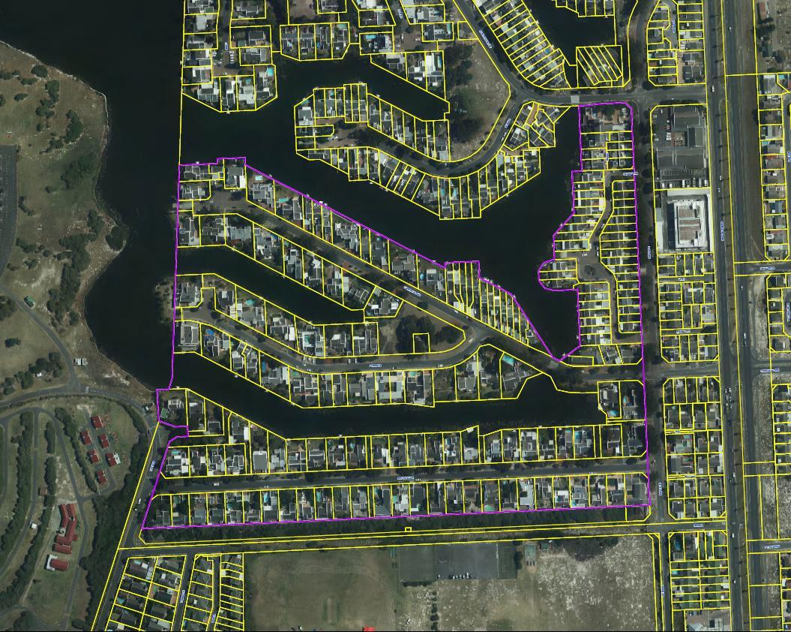
PROPOSED GEOGRAPHIC AREA

Slide 15
WHY THESE BOUNDARIES?
The proposed boundaries of the CID match the current camera coverage of the Marina South area and is currently funded by voluntary contributions which indicates support for safety initiatives
This is not the case for properties on the east side of Eastlake Drive, which could hamper efforts to create Marina South CID

Slide 16
WHY CAN’T SOME PROPERTIES BE EXCLUDED?
The CID By-law and Policy governing the CIDs establishment states that the boundary of the CID must be contiguous
This precludes properties not at the extreme end of Cannon Island from being excluded

Slide 17
HOW MUCH WILL IT COST?
Expenditure Budget for each year of the Business Plan
Year 1: R 600 000
Year 2: R 604 443
Year 3: R 647 063
Year 4: R 692 595
Year 5: R 741 242

Slide 18
HOW MUCH WILL IT COST?
MAINTAINING AND IMPROVING PUBLIC SAFETY
Year 1 | Year 2 | Year 3 | Year 4 | Year 5 | 5yr Total
432 000 | 462 240 | 494 596 | 529 218 | 566 264 | 2 484 318
Improving Public Safety requires more than cameras
With increased and stable funding
  improved monitoring of cameras
  and ARV responses to suspicious incidents in public areas
Will reduce crime before it has a chance to take place

Slide 19
HOW MUCH WILL IT COST?
BUDGET PER PORTFOLIO
Public Safety 72%
General Expenditure 13.8 %
Environmental Upgrading & Urban Maintenance 5.83%
Social Upliftment 5%
Contribution to the Rolling Bad Debt Reserve 3,0 %
Cleaning 0.33 %

Slide 20
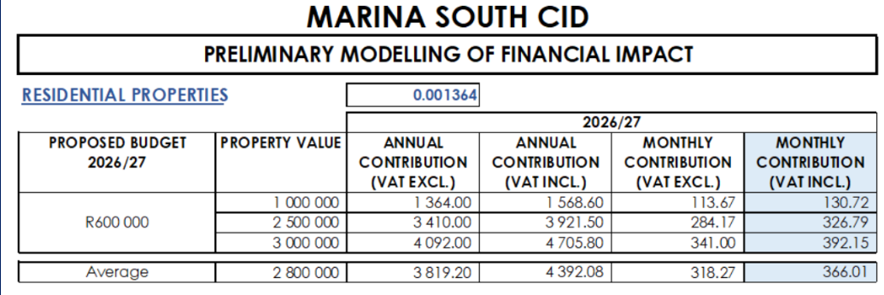
HOW MUCH WILL IT COST - Me?

Slide 21
WHAT HAPPENS NEXT?
Further Comments on the Final Business Plan may be made until 11th January 2026
  All documents available at marinasouthcid.co.za
  Email to marinasouthcid@gmail.com
Consent/Objection Process starts tonight
City Consideration and Approval/Non-Approval
  if > 60% vote in favour
Outcome communicated to Community
Possible implementation on 1st July 2026

Slide 22
TAKE NOTE
If a property owner currently receives a rebate (partial or in full) they are
Exempted from the voting process for the establishment of a CID
Exempted from paying the additional levy when established
Application can be made for a pensioners rebate on the City website
capetown.gov.za

Slide 23
THANK YOU FOR YOUR ATTENTION
The floor is now open for
Questions and Comments
www.marinasouthcid.co.za

Slide 24
CLOSURE
THANK YOU FOR YOUR ATTENDANCE
Remember
Let us have have your comments by 11th January
Relevant documents are available on our website marinasouthcid.co.za
Email your comments to marinasouth@gmail.com

