Slide 1
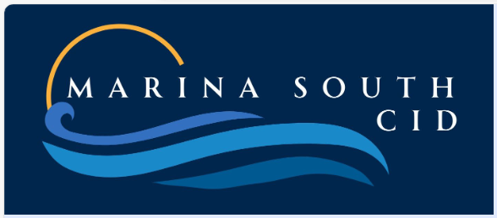
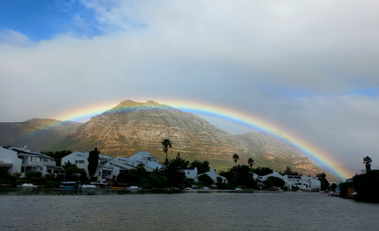
WELCOME TO THE FIRST PUBLIC MEETING TO DISCUSS THE PROPOSED
MARINA SOUTH CID (MSCID)
www.marinasouthcid.co.za

Slide 2
MEETING AGENDA
Business Plan Strategic Objectives
Draft Budget
Financial Impact
The Next Steps
Questions and Comments
Closure
Introducing the Steering Committee
What is a City Improvement District?
The CID Process
CID Governance
Why Marina South needs a CID
Proposed Geographic Area
Please save your questions & comments for the end

Slide 3
STEERING COMMITTEE
The first restart meeting of the Guardians, in wanting to create safer and more secure neighbourhoods,decided to explore the possibility of creating a CID in the Marina South area.
In terms of the CID By-law and the City's CID Policy, a geographically representative group of property owners within Marina South subsequently volunteered to form a Steering Committee, as required.​
Each of the precincts in the proposed Marina South CID area is represented as follows -
Battleridge - Demetri Qually
Battleridge - Charles Whaley
Fisherman’s Quay - Karen Hart
Fisherman’s Quay - Carrie Hampton
Cannon Island - Nicci Thompson-Evans
Cannon Island - Ulf Martz
Admirals Walk - Trevor le Roux

Slide 4
t
What is a City Improvement District ?
The CID Business Plan and Budget is funded by an additional rate levied on all property owners located within the CID area, except those who are exempted in terms of the Establishment process. There are 55 successfully operating CIDs.​
It is typically initiated by property owners who then form a Steering Committee and the establishment process is monitored by the City of Cape Town at every step of the way. ​
The CID, a Non Profit Company, is managed by a board of directors who are property owners in the area. Its activities are strictly monitored by the CCT.
Funding is transferred to the CID on a monthly basis and spent in accordance with the approved budget and business plan, which is publicly available for all additional ratepayers to review.​
A CID is established for a period of five (5) years, after which it must re-apply should it wish to continue. Alternatively, it may be dissolved at the end of the term if the members so decide.​

Slide 5
CID Process - Marina South
The Steering Committee drafts a 5-year business plan, vetted by City and presented to the local community at 1st public meeting (Tonight)
Comments are noted and local community given 30 days to submit written comments on the application and draft Business Plan (14 Aug -14 Sept)
It should note any changes that should be addressed in the draft business plan and provide feedback as to how these comments were addressed.​
Final Business presented to 2nd public Meeting (15 Oct). Consent and Objection phase commences after second public meeting and not before.
Community given 30 days to submit written comments on the application and final Business Plan (16 Oct - 15Nov)

Slide 6
CID Process - Marina South
Property owners consent on establishing the CID (1 property = 1 vote)
60% support is needed to lodge the application with the City of Cape Town
If approved by Council, all property owners, except those exempt, are obliged to pay additional rate. There is no provision for ‘opting out’
Subject to approval, this rate to be implemented from 1st July 2026
This is not a substitute for CCT (or MGDA) services - the CID works in conjunction with CCT to supplement municipal services.

Slide 7
CID Governance
• Registered non-profit company NPC: Directors (non-remunerated) elected by property owners
• Board responsible for:
- Oversight & implementation of 5-year business plan
- Tender process for service providers
-Management of accounts/payments
- Prepare monthly accounts, financial reports to Board & CCT
- Budget & Implementation Plan approved annually at AGM
- Audited annually & oversight from the City
• End of Term (5 years), must apply to renew.
- Can be dissolved at any time if requested by majority of property owners

Slide 8
Why Marina South needs a CID
In the Urban Management Survey, 90% of respondents in our area rated Public Safety as their highest priority.
- Meeting this need requires a holistic approach with quality equipment, new technology, control room monitoring with intelligent software.
- 24/7 regular patrolling and armed response by security branded vehicles to suspicious activity in public areas.
- Currently, this level of service is unsustainable as only 49% of residents contribute to the cost of street cameras, which is the source of funding.
- The improved and stable income model of the Marina South CID, will resolve this major issue.

Slide 9
Why Marina South needs a CID
The UMS also highlighted Cleaning, Beautifying & Environmental (61%) which will also benefit.
- Beautify verges and gardens with indigenous plants, using gardeners trained by local community organisations.
- Upgrade/beautify playgrounds.
- Work with the City to improve sidewalks and pathways.
- Request the City to install bins in streets where wind-blown litter collects.
- Coordinate with the City on grass mowing, tree trimming, speedy repairs to roads, pavements, drainage and leaks.
- Participate with civil society organisations in monitoring the management of Zandvlei water quality.

Slide 10
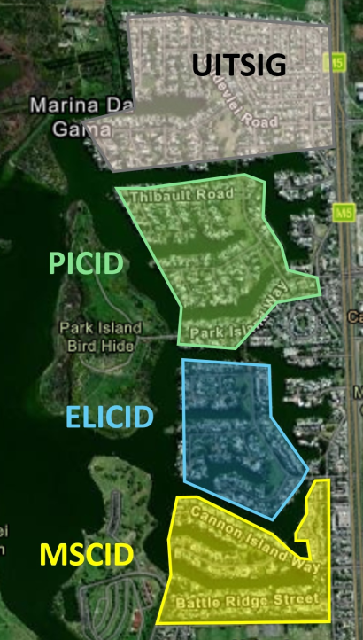
CID presence in Marina da Gama
Uitsig (investigating)
Park Island CID
Eastlake Island CID
Marina South CID (proposed)

Slide 11
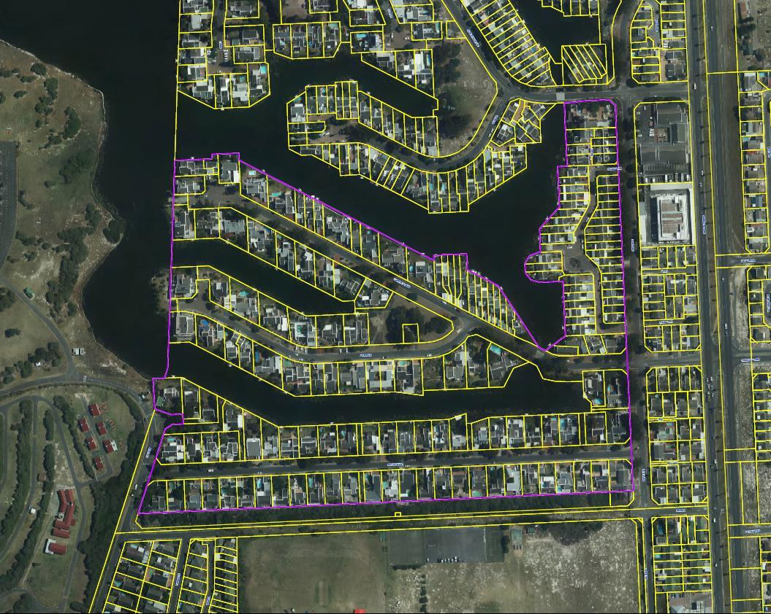
Proposed Marina South CID
(boundary in purple)

Slide 12
Proposed Geographic Area
Battleridge Precinct
Battleridge & The Row (69,71,73)
Cannon Island Precinct
Cannon Island Way & Admirals Walk
Fisherman’s Quay Precinct
Fisherman’s Quay, Tower Quay & western side of Eastlake Drive from Battleridge to Eastlake Island (many facing onto FQ).
(Commercially zoned and Gated Community properties have not been included)

Slide 13
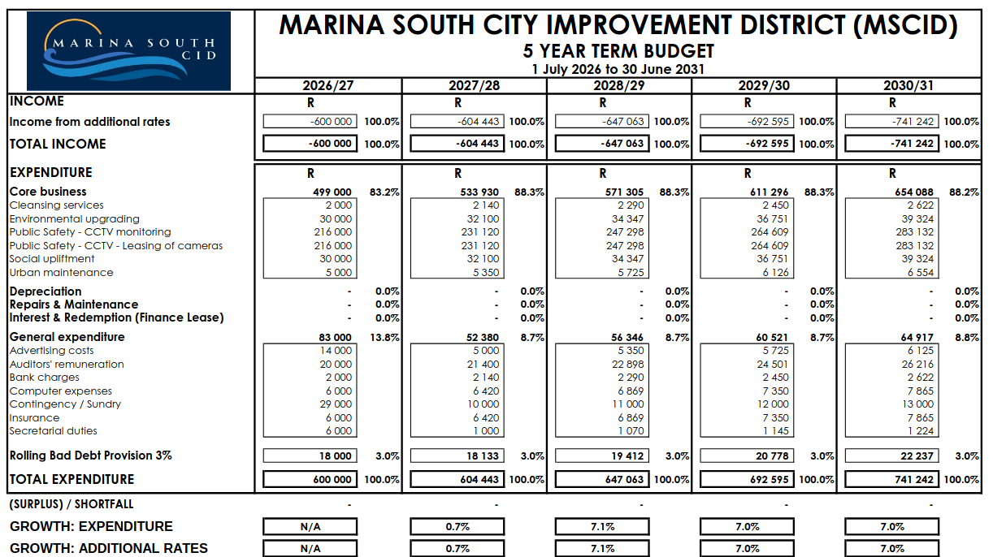

Slide 14
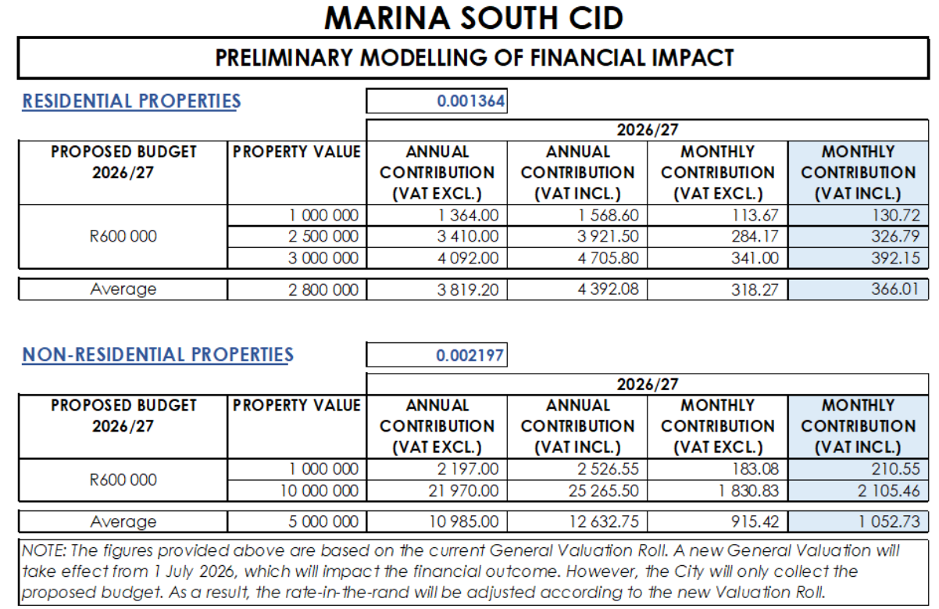
Financial Impact

Slide 15
Next Steps
This is the first of two public meetings required as part of the process.
Submit any comments in writing by 14 September
The Steering committee will address the comments and finalise the Business Plan and Budget
Attend 2nd Public meeting (15 October) after which you will be asked to consent or object.
We need (60%) of the ratepayers to consent in order to go ahead
- One property = One vote
- Voting only allowed by the ratepayer or their proxy
All relevant documents are available on our website marinasouthcid.co.za
Email your comments to marinasouthcid@gmail.com

Slide 16
The floor is now open for
Questions and Comments

Slide 17
CLOSURE
THANK YOU FOR YOUR ATTENDANCE
Remember
Let us have have your comments by 14th September
Relevant documents are available on our website marinasouthcid.co.za
Email your comments to marinasouthcid@gmail.com
The 2nd Public meeting is on Wednesday 15th October

